Slide 1
New Violations Report
Continuous Improvement Review Report for Scrum Masters
March 2019

Slide 2
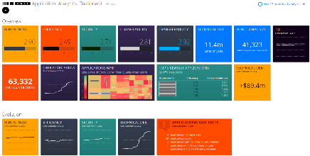




CAST for Continuous Improvement Prevention and Reduction of defects (Shift Left paradigm)
Change team behavior and introduce less defects
Focus on most impactful defects and give feedback to the team
Less defects throughout the SDLC cycle and delivery pipeline
4
Low risk
3
Moderate risk
2
High risk
1
Very high risk
Defect Origin
% Sev 1 + 2
Design defects 17.00%
Code defects 15.00%
Structural defects 13.00%
Data defects 11.00%
Requirements creep 10.00%
Requirements defects 9.00%
Web site defects 8.00%
Security defects 7.00%
Bad fix defects 4.00%
Test case defects 2.00%
Document defects 2.00%
Architecture Defects 2.00%
Severity 1 = total stoppage
Severity 2 = major disruption
Source: Capers Jones. Data collected from 1984 through 2011; About 675 companies (150 clients in Fortune 500 set); About 35 government/military groups; About 13,500 total projects; New data = about 50-75 projects per month; Data collected from 24 countries; Observations during more than 15 lawsuits.
Partnerships
Compelling Events
Proposed Solution
Benefits
Testing & QA Solution
Significantly reduce defects, mainly post-production defects.
Increase QA efficiency and better Time-to-Market.
Feedback to the ADM teams on bad and good practices, thus continuous skills improvement.
Track progress with facts.
Significant workload is spent for Rework
Increase in post-production incidents
High number of defect leakage from QA and long SDLC process
CAST Application Intelligence Platform
+
AND/OR
Agile/WF Application Develop-ment
PARTNER SOLUTIONS

Slide 3
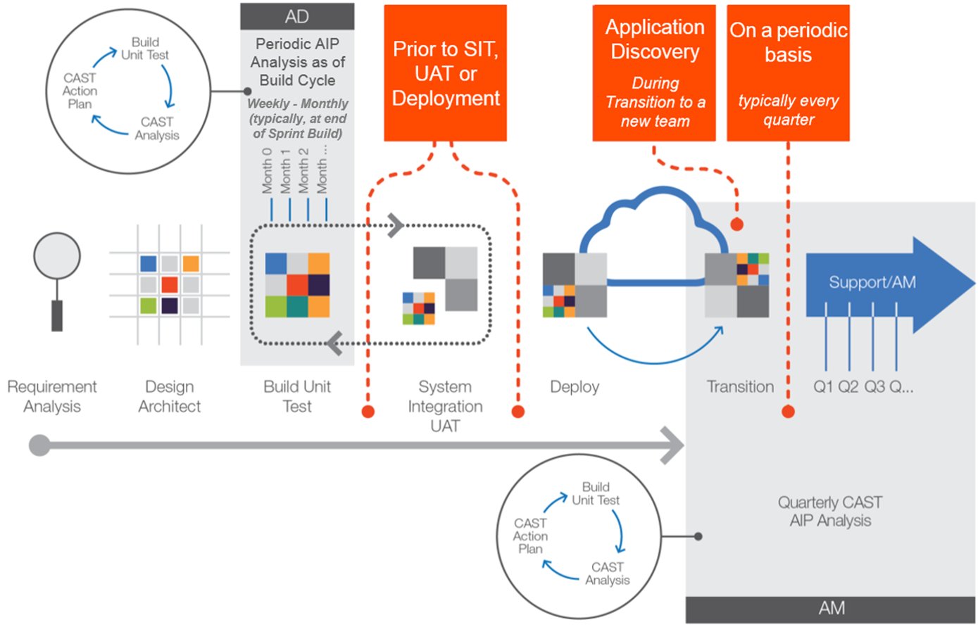
CAST Role in AD/AM Life Cycle Where AIP can be plugged into SDLC
AD: Waterfall & Agile

Slide 4
Waterfall, Agile and beyond … CAST AIP plugged in Continuous Integration Platform and DevOps value chain (CI/CD)
Agile Sprints
Prevent new technical debt by “shift left” and continuous team improvement
Allocate up to 10% of sprint cycle (or have a dedicated refactoring sprint) to fix technical debt that goes into the product backlog
Leverage on CAST REST API to integrate with 3rd party deployment tools (DevOps, Jira, etc.)
Sprint Backlog
Sprint Planning / Sprint Review
Build Gate (Current Sprint)
2
Product Backlog & Release Planning
Daily
RELEASE
Scrum
Weekly
Sprint
1
CAST Production / Quality Gate (n-1 sprint)
Automated Deployment
Continuous Feedback Loop
Approve
Approve
Database
QA
UAT
Prod Build
Middleware
Build
QA Env Build
Deploy
Test
UAT Env
Build
Deploy
Test
Deploy
Test
Infrastructure
Continuous
Integration
Continuous
Deployment
Continuous
Deployment
Applications
3
3
Tools
Auto Trigger
Auto Trigger
MAVEN / ANT
JENKINS / MS TFS
CAST AIP
SELENIUM
CHEF / PUPPET

Slide 5





Focus: Continuous Improvement Use Case “Shift Left” use case will drive core Value Realization
A
STARTING POINT - FIRST SCANS
Trending prior to CAST
Accumulated New Non-Functional Defects
Start with 2/3 releases (upfront if possible) and focus on new non-functional defects detected by CAST, and how to avoid them – Educate the team for Critical Violations
“NO REMEDIATION PLAN”
1st CAST scan (s)
A
C
B
Number of Defects
PERIODIC SCANS
B
Armed with new knowledge and suggestions, there is “CHANGE IN BEHAVIOR” and the team will introduce fewer non-functional defects as the project progresses, eventually driving to zero.
Industrialization will help improve effectiveness and efficiency.
B
New Non-Functional Defects
WEEK (Agile)
1
2
3
4
5
6
7
8
9
10
11
12
13
MONTH (Waterfall)
C
OPTIONAL – ON DEMAND ONLY
Some defects may be fixed only IF NEEDED AND FUNDED as part of a refactoring plan or sprint, reducing accumulated defects in the project. Otherwise, proceed with B type of re-scans (No remediation plan, but team education and management empowerment)
Focus on New Violations
Core savings will result from defect avoidance (not defect fixing) by focusing on the newly introduced violations release over release… by educating the team and empowering management (e.g. during Sprint Review meetings, in Agile)
Core savings will not result from remediation Plans!
Riskiest
Most Common
5
932
13
125
3
98
6
91
See slide 17 for rationale

Slide 6


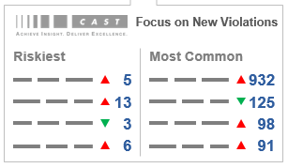



Focus: Continuous Improvement Use Case … and benefits will be delivered when Management cares
CAST Output focusing on deltas, release over release
Educate Which Non-Functional Defects to Avoid
Drive Quality Improvement
POSITIVE FEEDBACK LOOP with management empowerement
CAST outputs will be leveraged by the application lead (PM, AO, Manager, Scrum Master) to focus on deltas.
Each scan results are presented to the team for education purposes and in order to avoid introducing same defects over and over again.
A positive feedback loop is introduced and management is empowered to coach the team and improve performance.
Can be leveraged in Waterfall, Agile and Devops.
SCRUM MASTER or PROJECT LEAD
Tracks sizing, Quality, and Complexity trends. Manages app quality through behavior change
OR
Trending is good: less non-functional defects are being introduced, team is improving code quality and containing technical debt. Continuous improvement is here to stay and we can prove it.
Trending is bad: same non-functional defects are introduced again and again, technical debt is increasing despite time spent by the team. Management must act accordingly, supported with facts.

Slide 7


Focus: Continuous Improvement Use Case Not all violations are born equal
What new structural defects were introduced, and how could we have avoided them?
CAST Output focusing on deltas , release over release
deltas
How do we avoid creating the same defects we introduced in the last sprint?
TOP Newly Introduced Critical Violations
Riskiest (Criticality, PRI)
Most Common Critical Violations
5
932
How can we speed up future sprints?
13
125
SCRUM MASTER or PROJECT LEAD
REVIEW
3
98
What kind of architectural violations should be avoided?
6
91
Educate First
How can we avoid coding that results in security breaches, performance issues, too many outages, and slow time-to-market?
Example of levers are provided by CAST to focus on the most harmful violations worth monitoring –
Criticality, PRI, TRI

Slide 8
New Violations Report - Context
Who are the Education Report consumers?
Scrum Masters
Project Managers
Architect\Technical Lead
When to generate the report?
At the end of each sprint (or more frequent if needed)
Or at the end of a development cycle with significant code changes
How?
It is a batch program that can be executed automatically by a scheduler after a new CAST analysis
To Get What?
The list of the NEW violations since the previous CAST analysis
The list of the FIXED violations since the previous CAST analysis
To Do What?
To educate the development team who is not following coding and architecture best practices
To reward the development team who is following coding and architecture best practices
To fix the new violations as part of the new sprint (before to QA\Prod) if possible

Slide 9
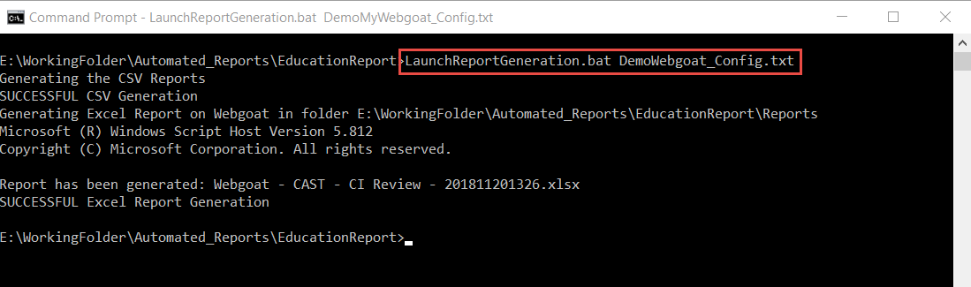
New Violations Report - Execution
In a Windows command prompt:
1. Modify the configuration file with the right parameters (see documentation)
2. Execute the LaunchReportGeneration.bat ApplicationName_Config.txt
LaunchReportGeneration.bat ApplicationName_Config.txt
Through a job scheduler like Jenkins:
Same command line as above executed by a scheduler

Slide 10
New Violations Report - Outputs
The New Violations Report generates:
5 CSV files in a zip file (intermediate files)
1 Excel file (main report)
The New Violations Excel file contains 2 sheets:
Summary on the new and fixed violations for the all rules checked by CAST AIP
List of new and fixed violations for the all the rules with a link to the violation in the Engineering Dashboard

Slide 11
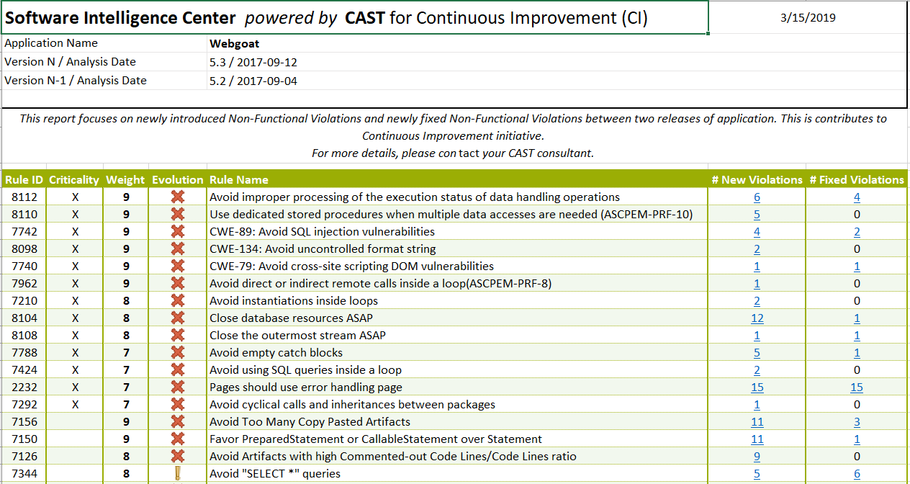
New Violations - Summary

Slide 12
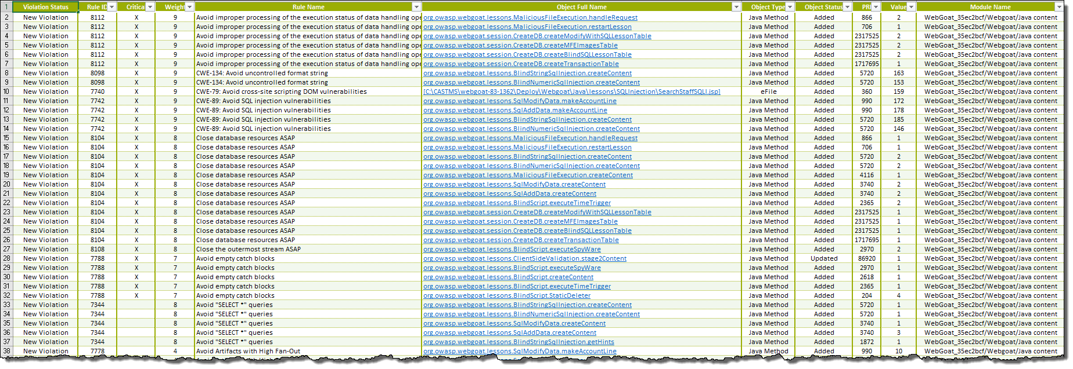
New Violations – List of New and Fixed Violations

